Slide 1
论文阅读报告
——Deep Progressive Reinforcement Learning
for Skeleton-based Action Recognition
时间：2019年12月15日

Slide 2
论文介绍
文献题目：Deep Progressive Reinforcement Learning
for Skeleton-based Action Recognition
作 者：Yansong Tang, Yi Tian, Jiwen Lu, Peiyang Li, Jie Zhou
会 议：2018 IEEE Conference on CVPR

Slide 3
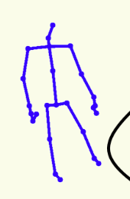
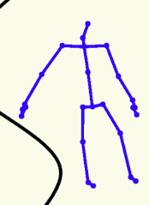
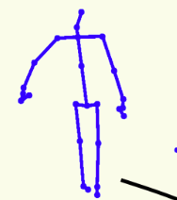
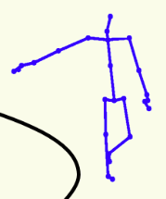
针对的问题
Most skeleton-based action recognition consider all of the frames in a sequence as equally important, which fails to focus on the most representative frames.
Take a video of action ‘kick’ as an example, there are some frames in which the subject stands upright, as well as other frames showing the subject kicks out the leg. The latter are more informative for recognizing this action.

Slide 4
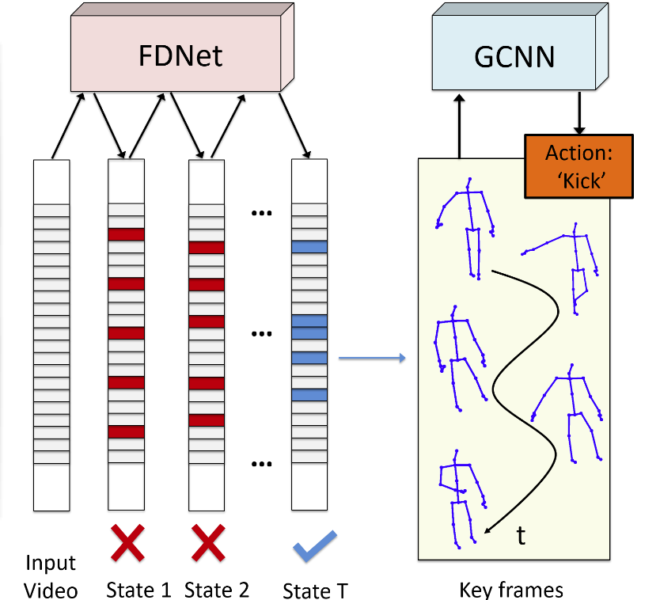
论文的目的
This paper aims to distil the most informative
frames and discard ambiguous frames in
sequences for recognizing actions.
Since the choices of selecting representative
frames are multitudinous for each video,
we progressively adjust the chosen frames
by taking two important factors into account:
(1) the quality of the selected frames
(2) the relationship between the selected
frames to the whole video.

Slide 5
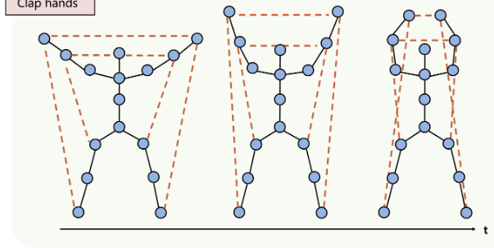
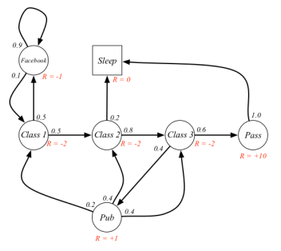
两个前提
Modelling human body as a graph
The vertices of the graph are presented
as the blue dots, which contain the
3D coordinates of human joints,
while the edges reflect the relationships
between joints,
Deep Reinforcement Learning
Reinforcement learn-ing can be
mathematically formulated as a Markov
decision process.

Slide 6
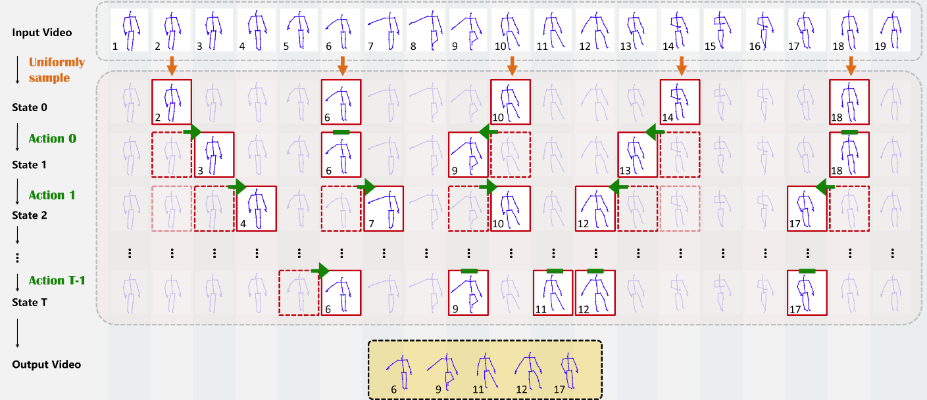
采用的方法
Process of selecting key frames in skeleton-based videos progressively
Given a skeleton-based sequence, we first uniformly sample several frames.
Actions, which are obtained by the states and FDNet, denote the direction of ‘shifting
to left’, ‘staying the same’ or ‘shifting to right’ at the next step for each selected
frame.

Slide 7
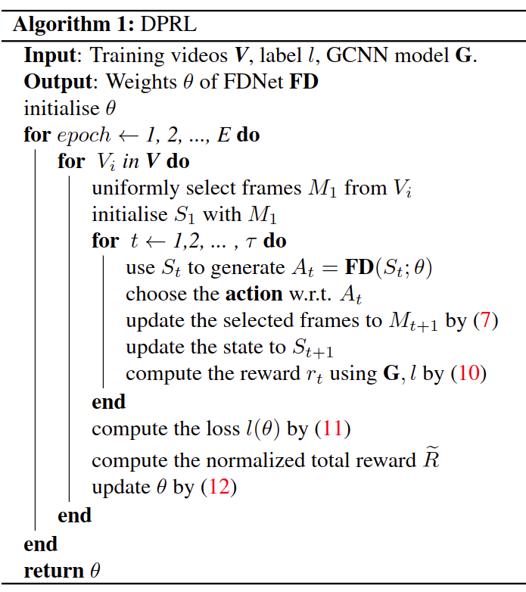
实现的步骤
The pipeline of our DPRL is summarized in Algorithm 1
For all of the skeleton-based videos in the training set,we first sample their frames uniformly to obtain the sequences in fixed size.Then, we fix the parameters in GCNN to train FDNet and update the selected frames for each video in the temporal domain, which are used to refine the GCNN. These two models promote each other mutually, as GCNN provides rewards for FDNet and FDNet selects key frames for refining GCNN. The better GCNN is, the more accurate rewards will be provided. The higher quality the selected frames have, the better GCNN can be refined.

Slide 8
数据集
NTU+RGBD Dataset :This is the currently largest dataset for action recognition with more than 56 thousand sequences and 4 million frames. The dataset was captured from 40 different human subjects and has 60 classes actions. Keypoint Estimation Subnet
SYSU-3D Dataset :The SYSU-3D dataset contains 480 sequences and 12 different actions performed by 40 persons. The 3D coordinates of 20 joints are associated with each frame of the sequence.
UT-Kinect Dataset:This dataset includes 200 skeleton sequences with 20 skeleton joints per frame.There are 10 types of actions and each of them is performed by 10 subjects twice.

Slide 9
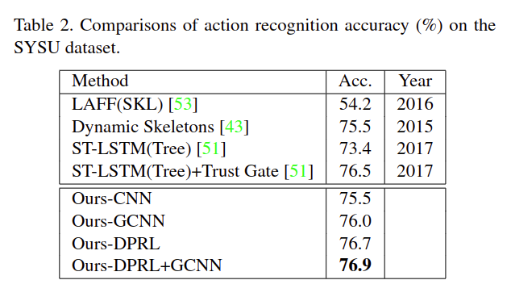
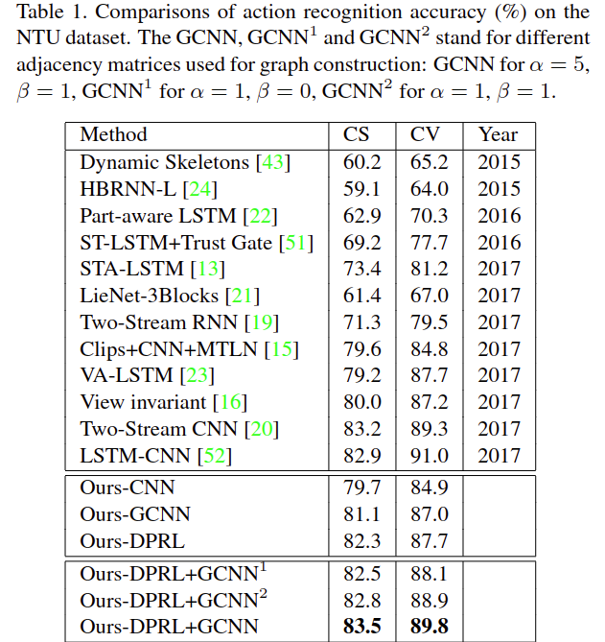
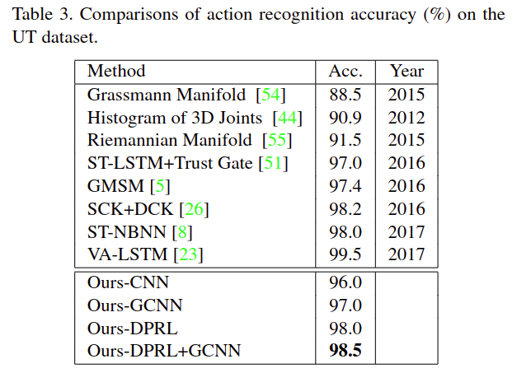
实验结果
SYSU-3D Dataset
UT-Kinect Dataset
NTU+RGBD Dataset

Slide 10
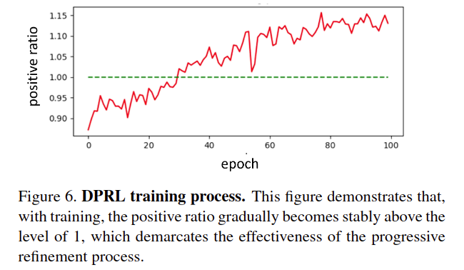
实验结论
In this paper, we have proposed a deep progressive reinforcement learning (DPRL) method for action recognitionin skeleton-based videos, which aims to select the most informative frames of the input sequences.
Our approach achieves very competitive performance on the widely used NTU, SYSU and UT datasets.

